Slide 1

NREGA
ANALYSIS
IN Power BI

Slide 2

Table of
CONTENTS
01
02
03
04
Introduction
Dataset Overview
Objective
Importing data
05
06
07
Exploratory Analysis
Area of improvement
conclusion

Slide 3

INTRODUCTION
The National Rural Employment Guarantee Act (NREGA) is an important Indian government scheme that was launched in 2005. In 2009, it was renamed as Mahatma Gandhi National Rural Employment Guarantee Act (MGNREGA). It guarantees 100 days of wage employment annually to rural households. As of 2022-23, there are 15.4 crore active workers under the Mahatma Gandhi National Rural Employment Guarantee Act (MGNREGA).
Workers engage in various public works projects, contributing to rural development and infrastructure. By ensuring employment opportunities in poor regions, it plays a crucial role in enhancing the livelihoods of rural residents and promoting sustainable progress in India's rural landscape.
The wages earned through MGNREGA provide a source of income for rural families. Workers can consider options like Fixed Deposits (FDs) for saving portions of their earnings. FDs offer secure returns and flexibility, helping those employed under MGNREGA build financial stability over time.

Slide 4

DATASET
The dataset used for this analysis is sourced from official government records and contains information related to NREGA implementation across various states and districts in India.
State name: Name of the Indian state.
District name: Name of the district within the state.
Total No. of Jobcards issued: The total number of job cards issued to rural households.
Total No. of Workers: The total number of workers registered under NREGA.
Total No. of Active Job Cards: The number of active job cards at a given point in time.
Total No. of Active Workers: The number of workers currently engaged in NREGA works.
SC workers against active workers: The count of Scheduled Caste workers among active workers.
ST workers against active workers: The count of Scheduled Tribe workers among active workers.
Approved labour Budget: The budget allocated for labor under NREGA.
OVERVIEW

Slide 5
Objective
OBJECTIVE
This project aims to analyze and visualize the NREGA dataset to extract meaningful insights.
Data preprocessing and cleaning to ensure data quality.
Exploratory data analysis (EDA) to identify patterns, trends, and disparities in NREGA implementation.
Utilizing data visualization techniques to present key findings effectively.
Drawing actionable insights to inform policymakers and administrators about the strengths
and weaknesses of the NREGA program.

Slide 6

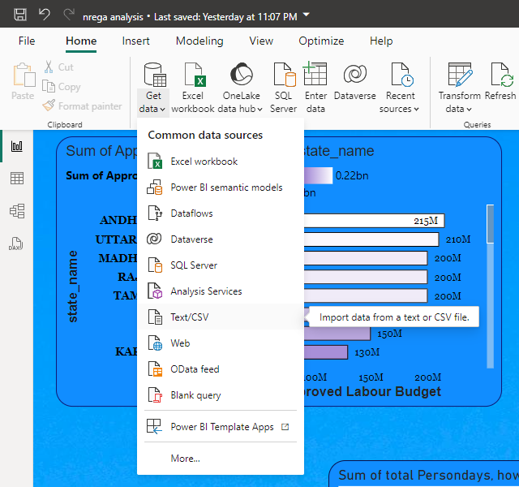
IMPORTING DATA
To import data in Power BI
Click on GET DATA >> Text/CSV file >> select file >> ok.

Slide 7
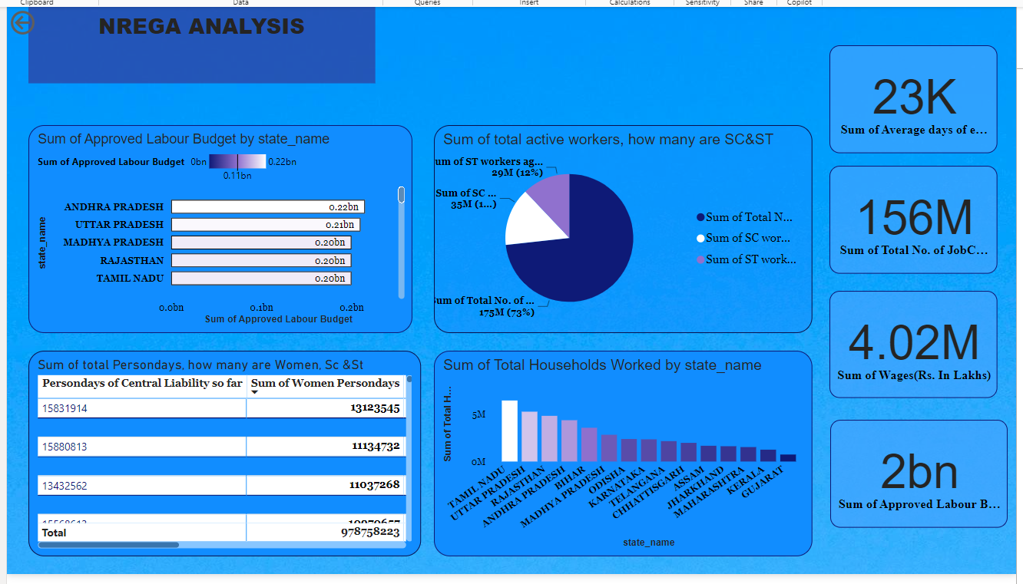
EXPLORATORY ANALYSIS
WHAT IS TOTAL APPROVED BUDGET IN EACH STATE
Out of total workers how many are SC & ST
Out of total persondays how many are Women, SC & ST.
Total household worked completed 100 days of wages in each state.

Slide 8
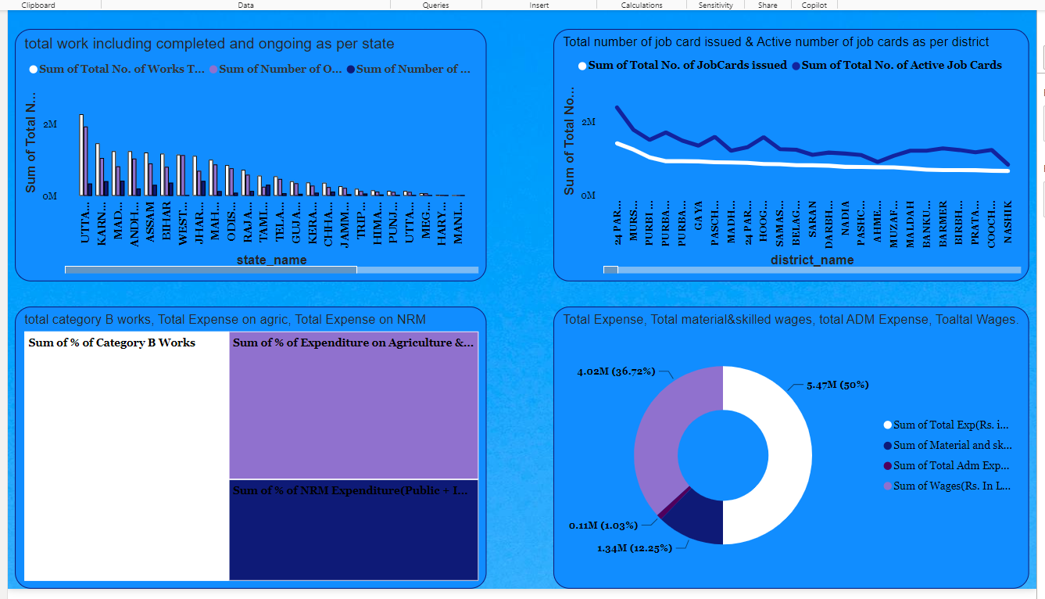
EXPLORATORY ANALYSIS
HOW MUCH WORK IS COMPLETED & ONGOING OUT OF TOTAL WORK
Out of total job cards issued how many are active as per district
Percentage of works and expenses
How total expense is allocated

Slide 9


Area of
IMPROVEMENTS
No or Low budget is approved in states like Ladakh, West Bengal, Goa, etc.
Out of total active workers SC workers are comparatively high than ST workers which creates a caste discrimination
There is a huge gap seen between ongoing work and completed work which means a lot of work is still pending
Number of active job cards are comparatively low than number of cards issued in each district.
The state where highest budget were assigned didn't complete the total number of household completed 100 day wage employment .

Slide 10
CONCLUSION
With the help of visualization and careful analysis I came to know the area of improvements and the things NREGA scheme lacks.
To improve those things govt should provide equal opportunity to both
SC & ST people.
More budget should be given to states like Ladakh, West Bengal, etc.
The gap between ongoing and completed work should reduce.
Job cards should get issued as per requirement.
THANKYOU!!!

